Slide 1
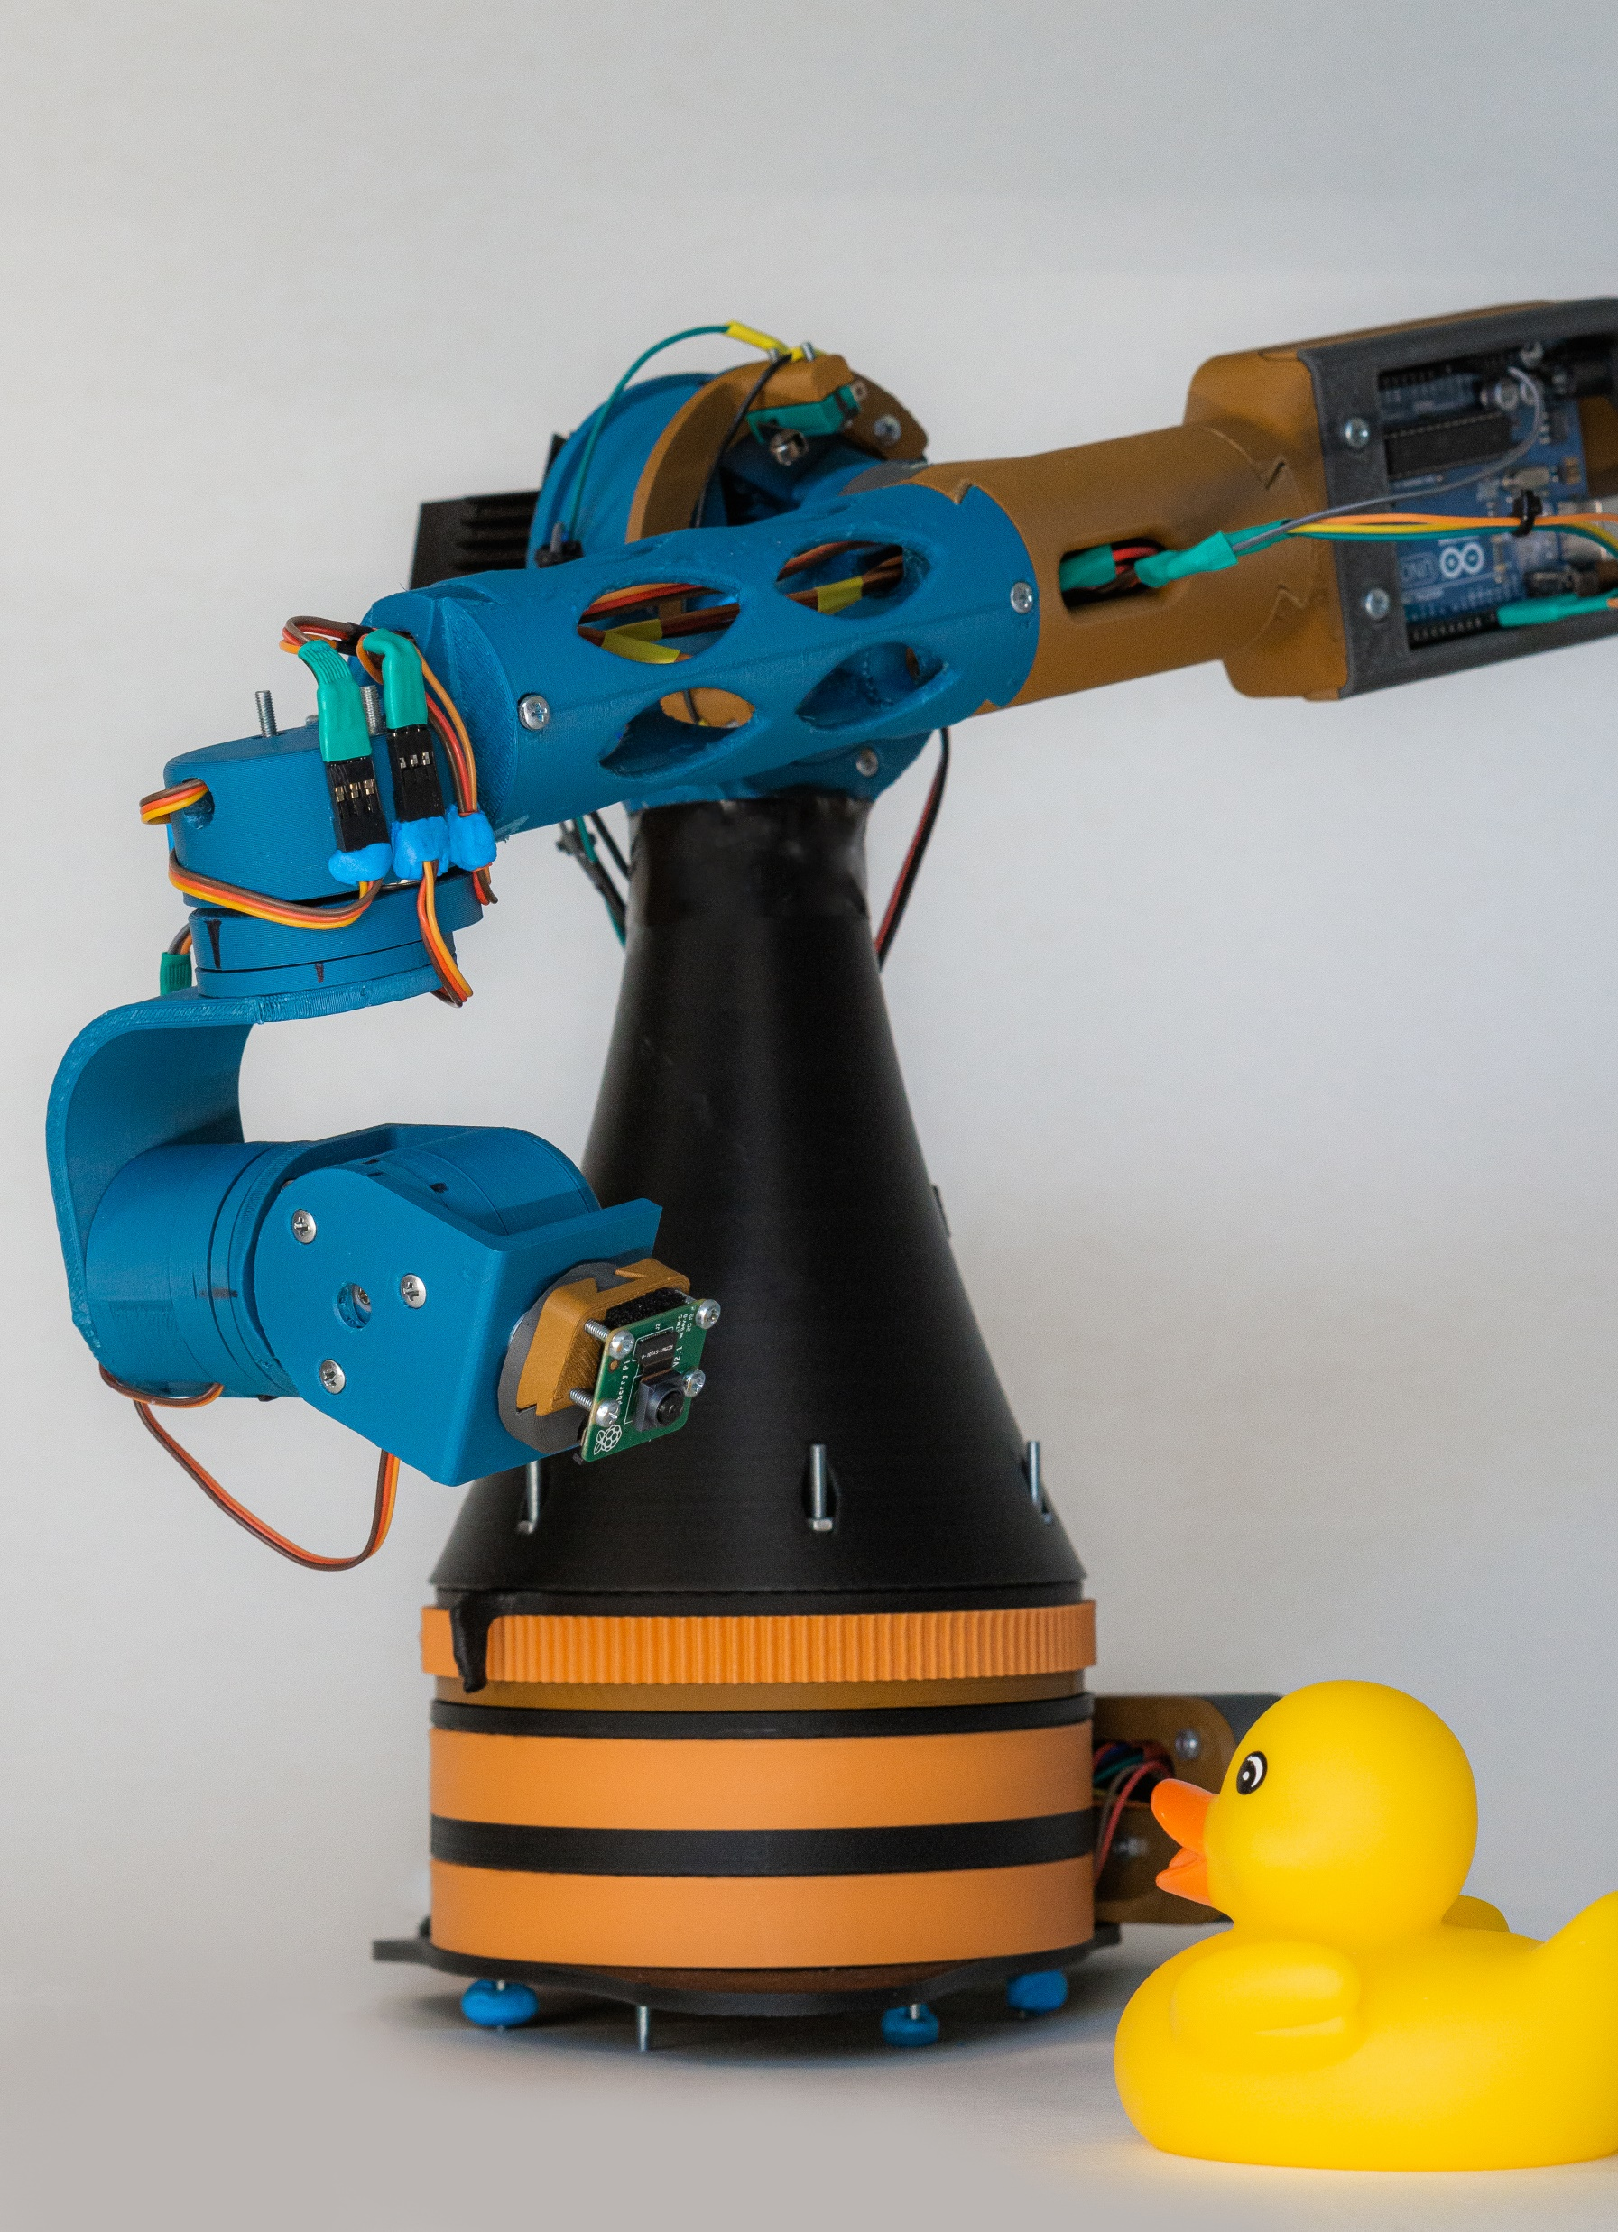
Cinebot Alpha
Course project of
Nikola Totev
for
Practical robotics & Smart Things
Sofia University
July 2020

Slide 2
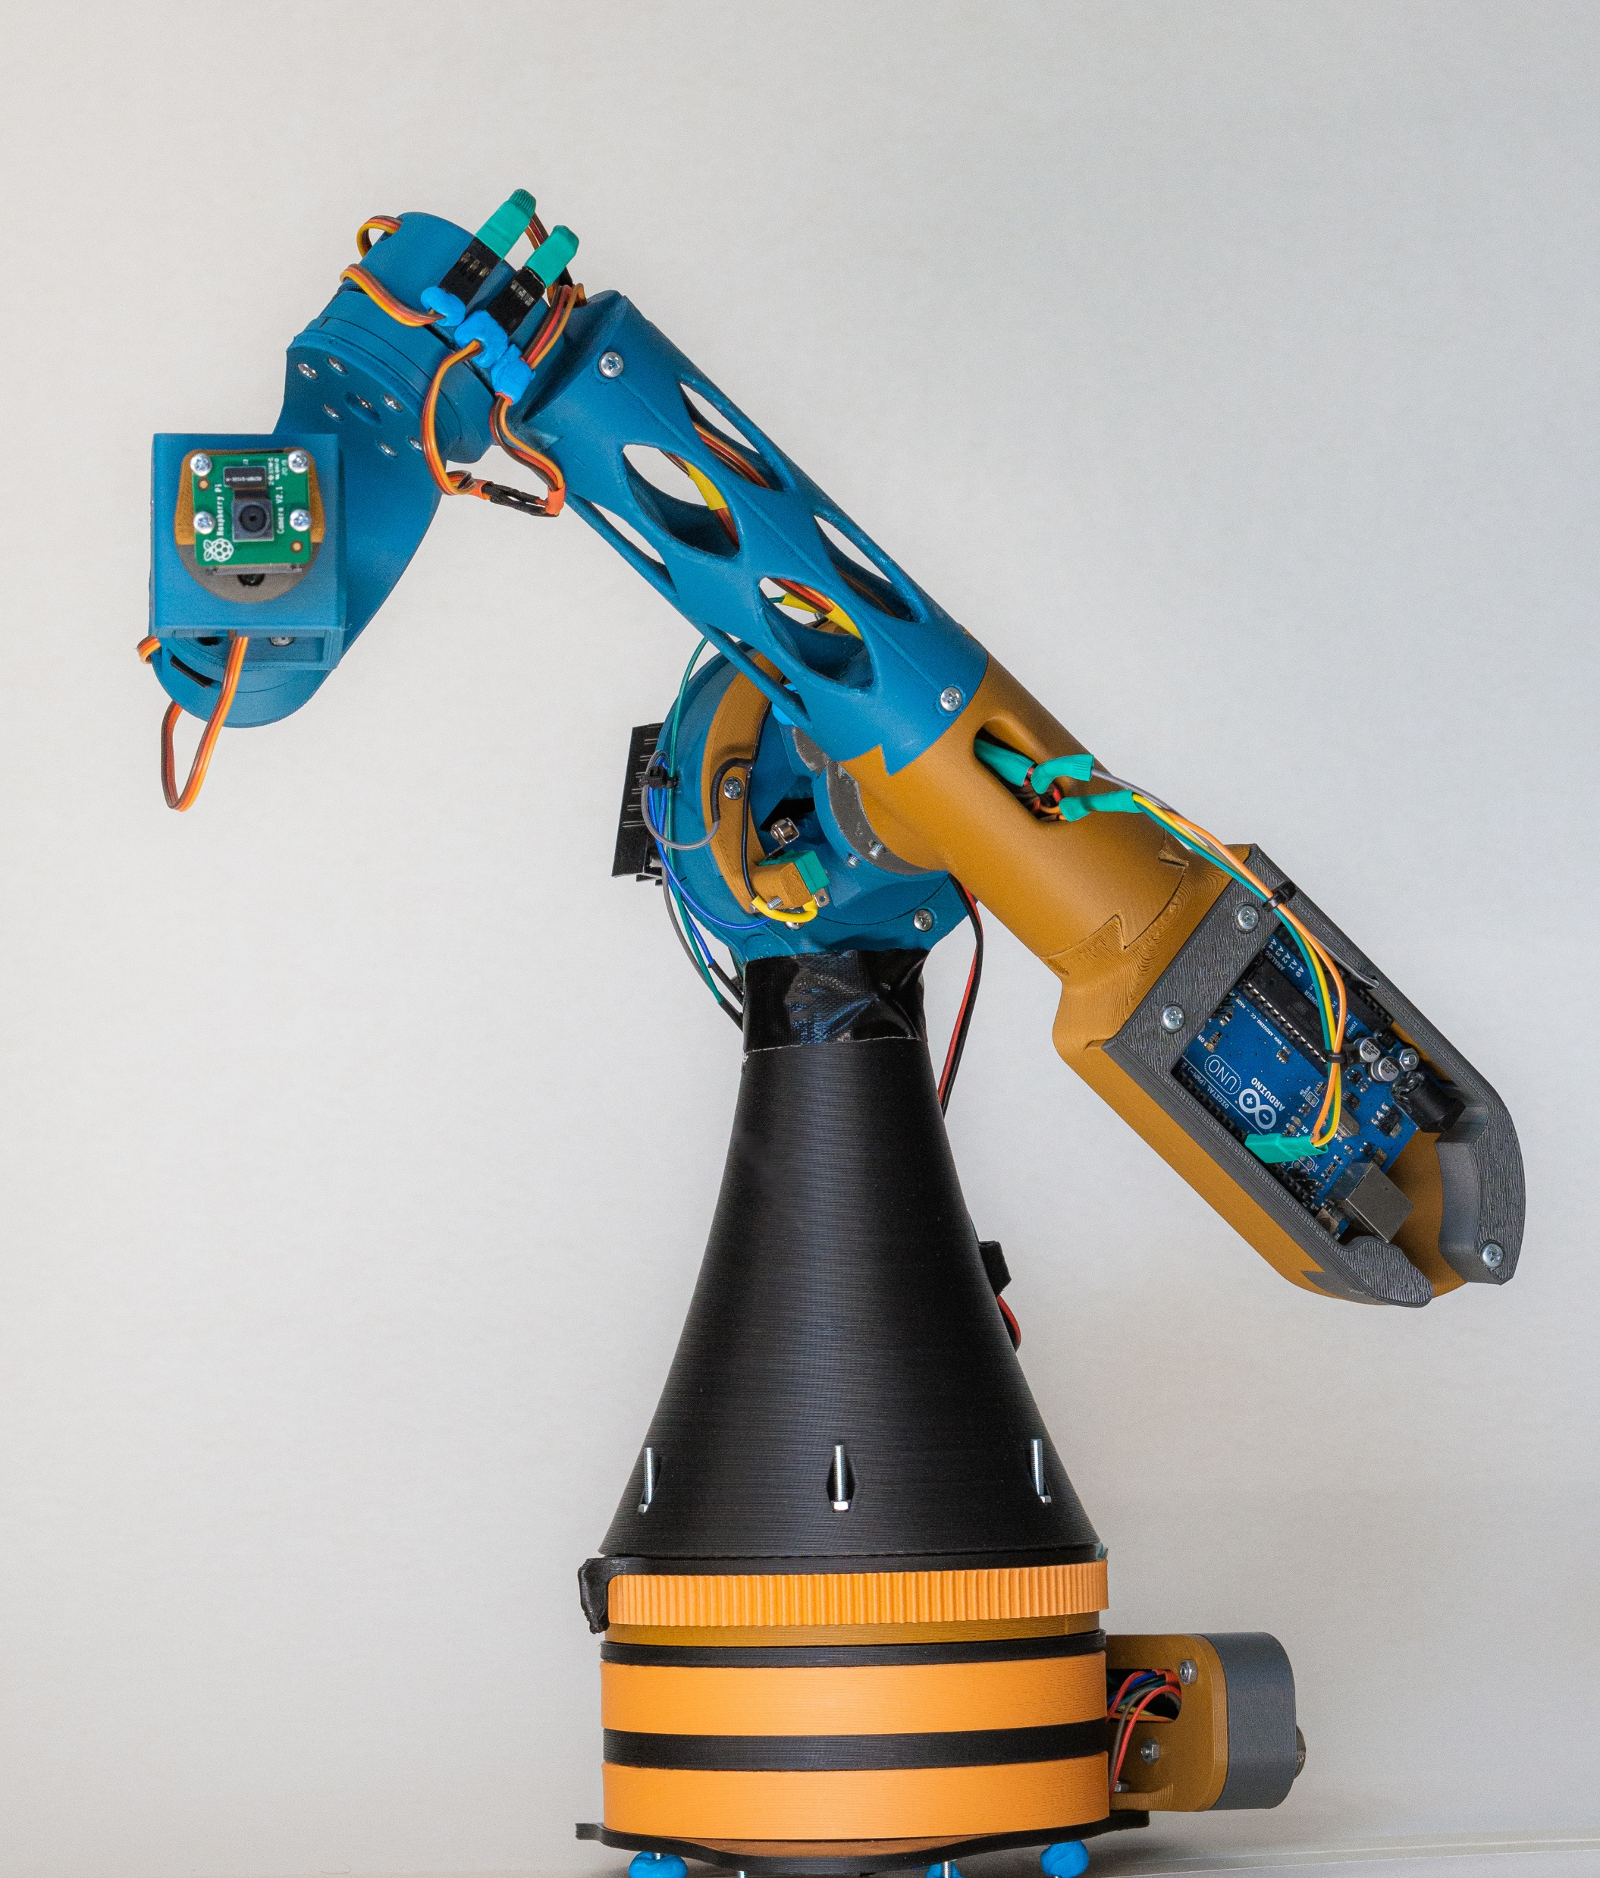
Project overview
Design Concepts
Design challenges
Key features
Development possibilities
Demo

Slide 3
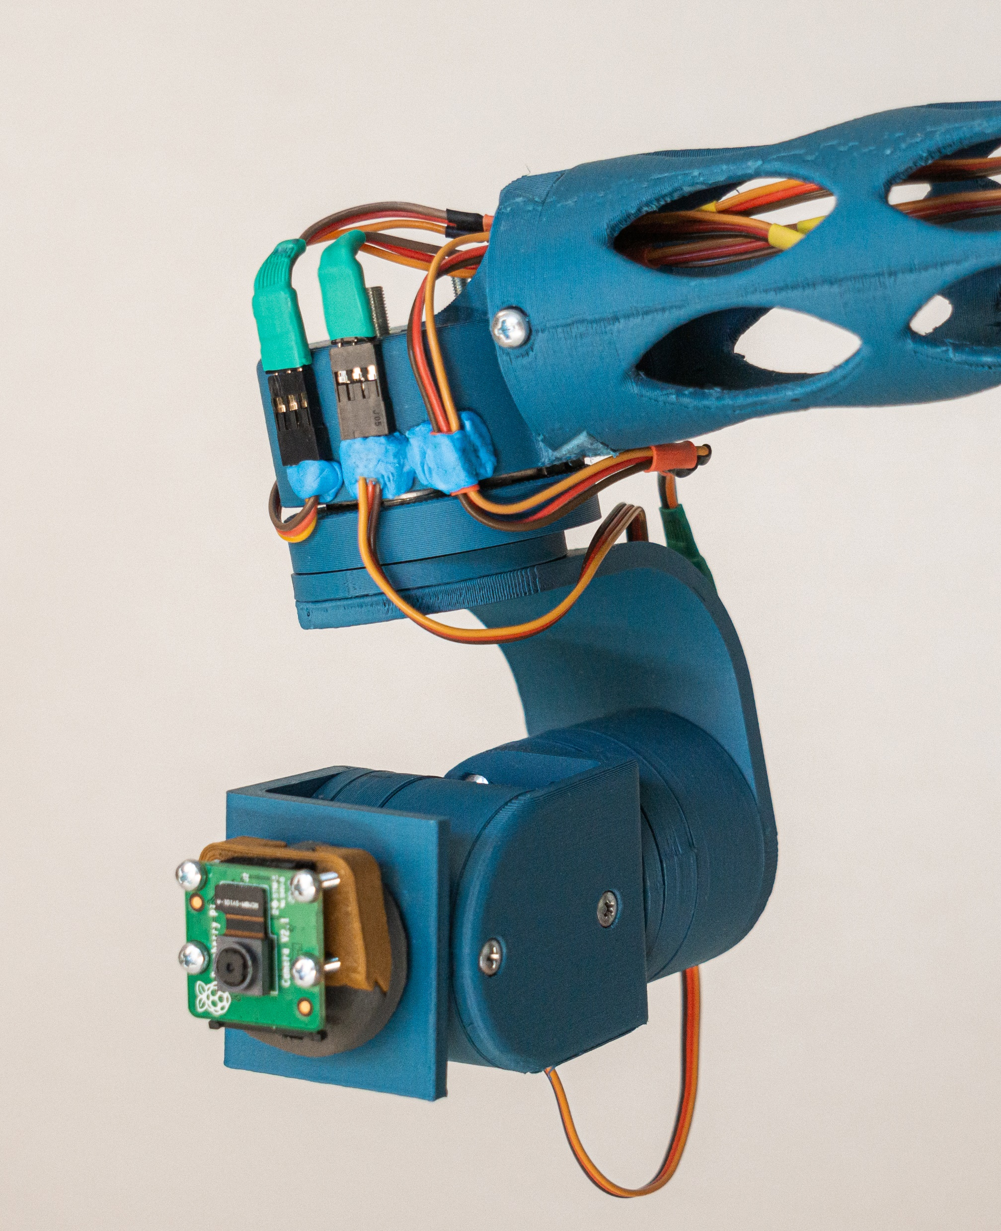
Project overview
What is it?
How is it made?
What can it do?
What can it be used for?

Slide 4
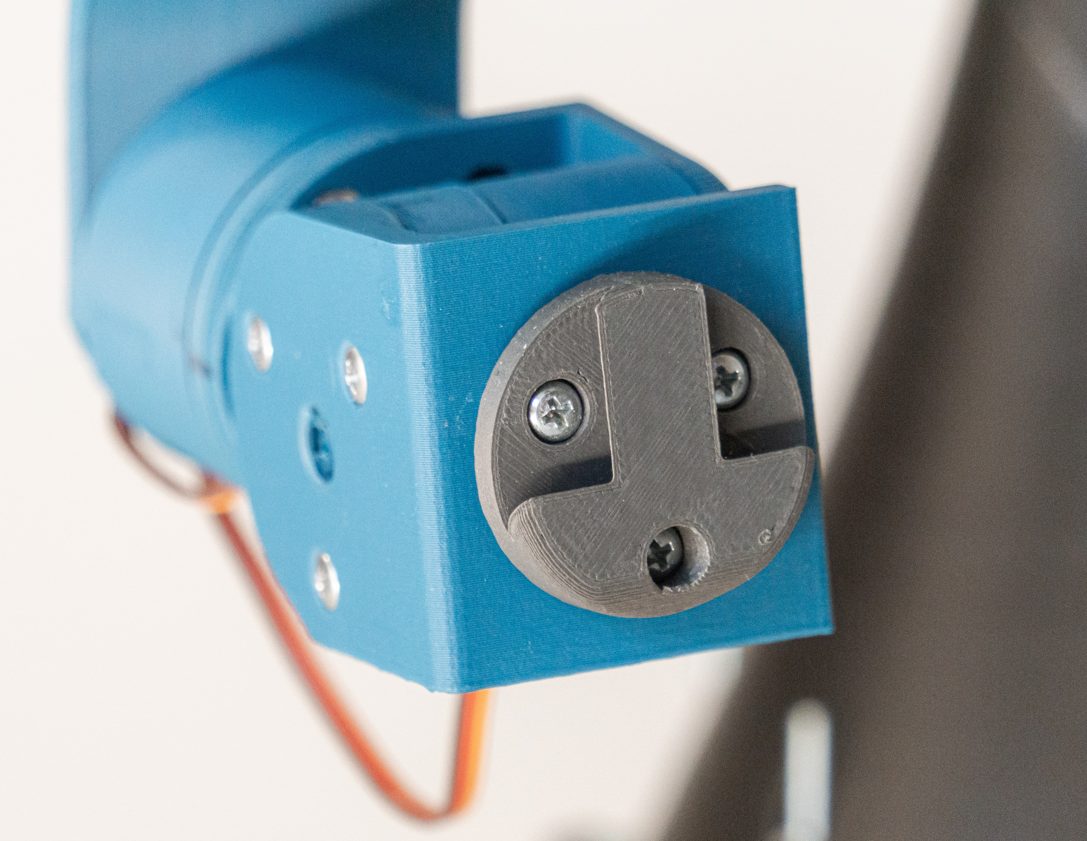
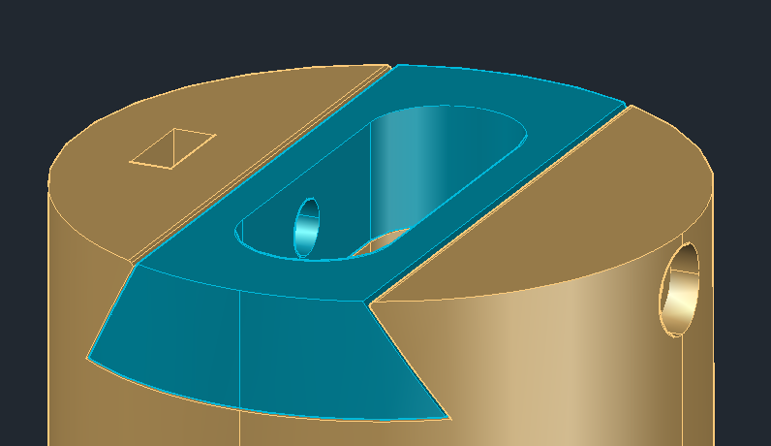
Design Concepts
Modularity
Simplicity
3D Printable

Slide 5
Design Challenges

Slide 6
Key Features

Slide 7
Development possibilities

Slide 8
Time for a demo

